Slide 1
The Silent Reformers:
The role of Clerks in strengthening and transforming parliament
Presentation to the
Society of Clerks-at-the-Table in Commonwealth Parliaments
2025 Annual Meeting, Barbados
Tom Duncan,
Clerk of the Legislative Assembly for the
Australian Capital Territory

Slide 2
What did the first Clerk look like?

Slide 3
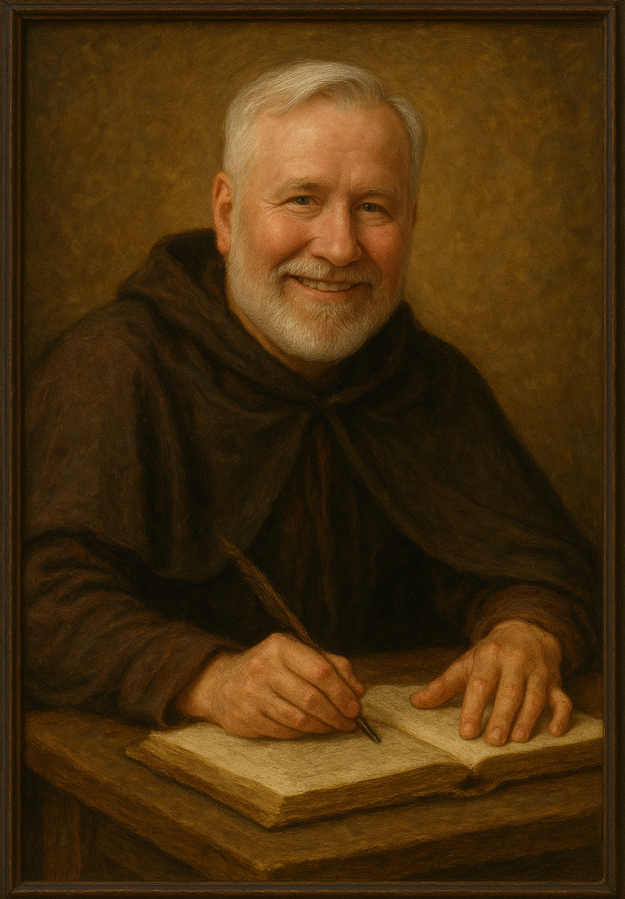
What did the first Clerk look like?
AI-generated portrait from modern and historical references

Slide 4
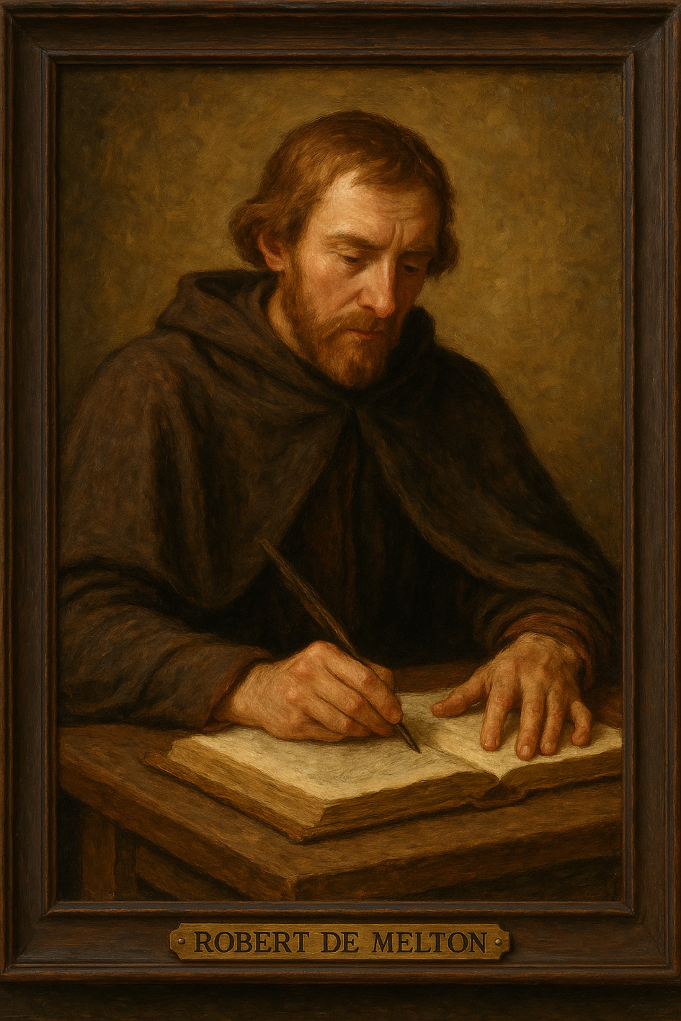
What did the first Clerk look like?
A possible portrait of Robert de Melton, 12th century English lawyer, generated by AI from historical references

Slide 5
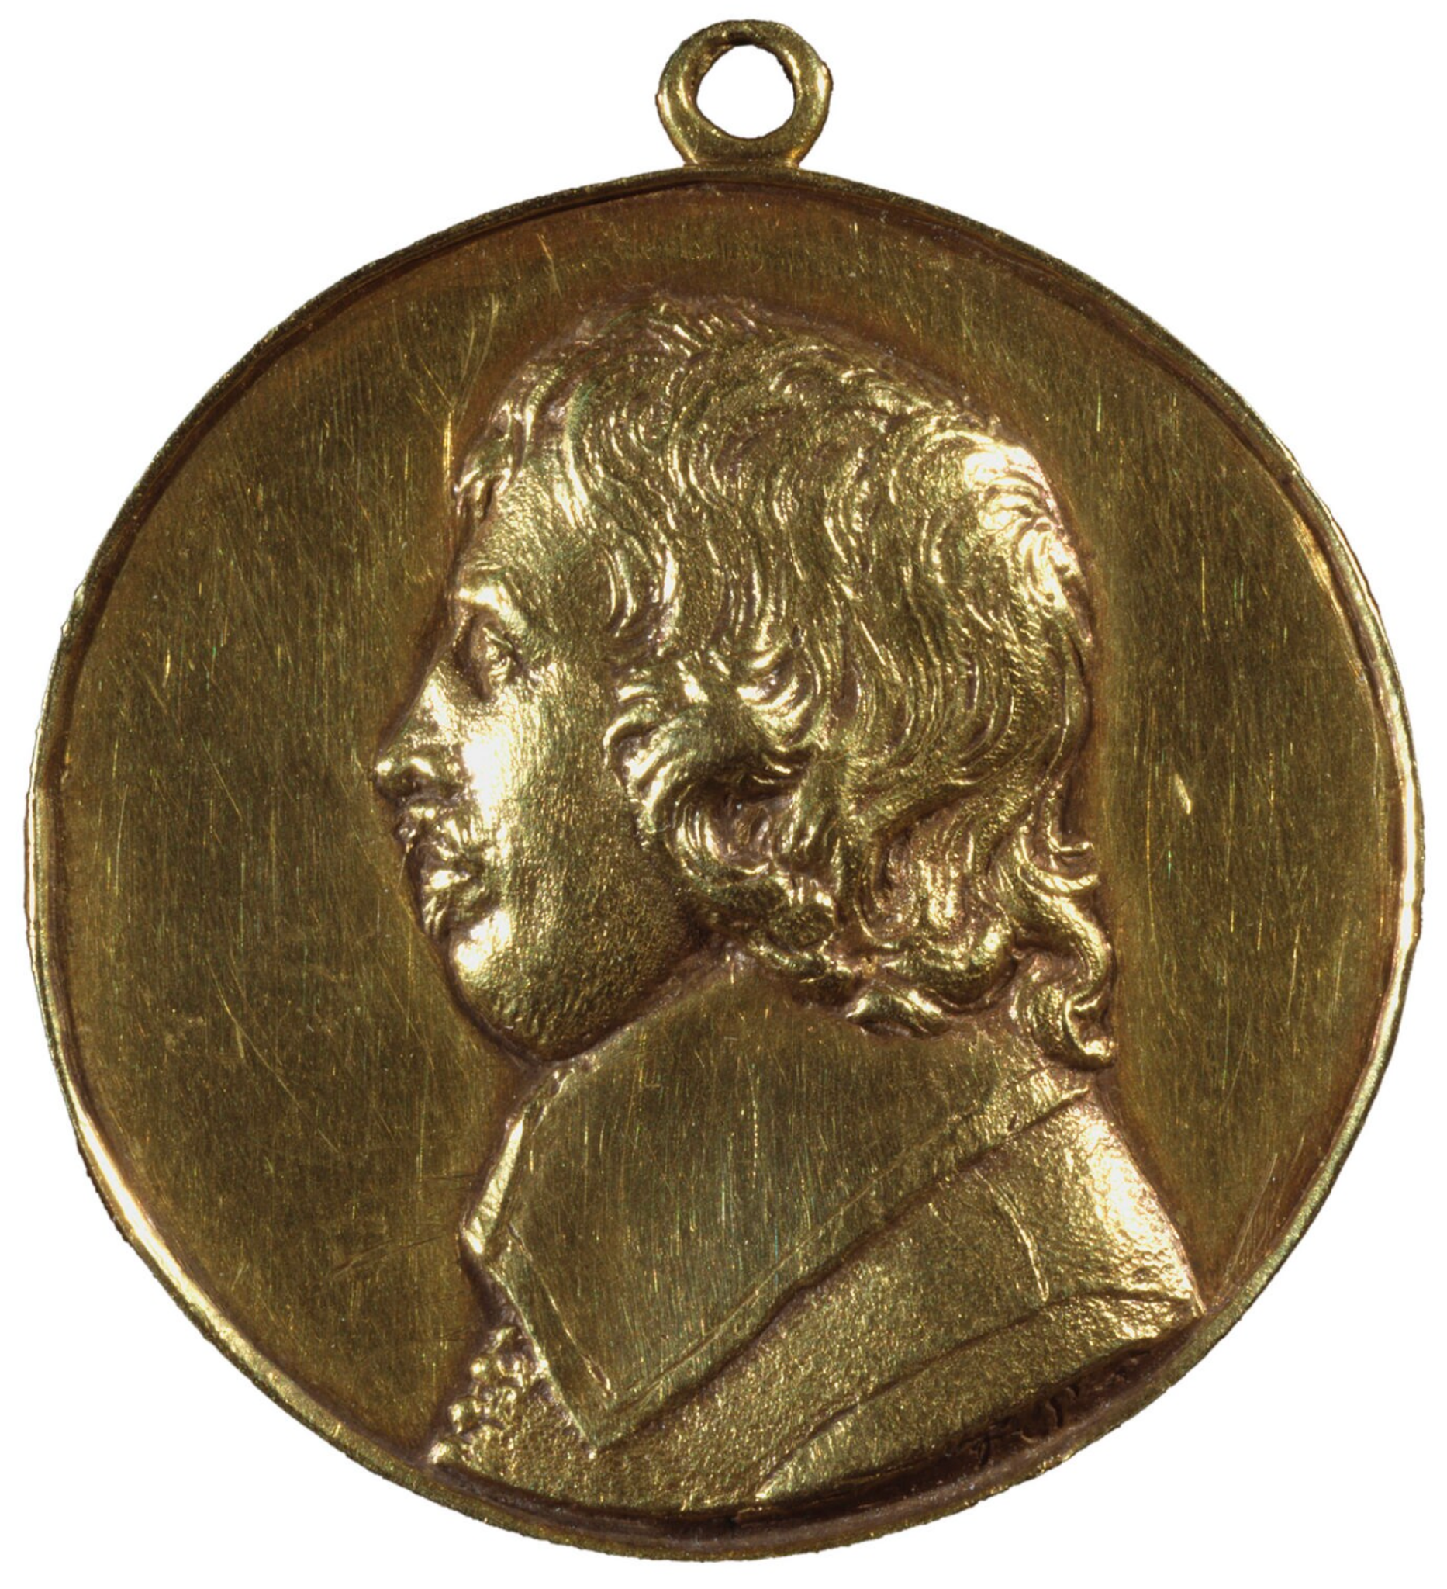
What did the first Clerk look like?
Henry Scobell (c.1610–1660),
Clerk of the Parliament.
Gold medal, 1649, by Thomas Simon (1618-1665), Engraver, National Portrait Gallery, UK, https://www.npg.org.uk/collections/search/portrait/mw05651/Henry-Scobell

Slide 6
Filling the position of Clerk or Secretary to a Parliament is not just another staff appointment. A parliament must look for a truly remarkable person of unassailable character.
S.N. Darkwa
… We have a lot of other responsibilities and roles to take on as part of the Clerk mantle e.g. pastoral carer, confessor and handmaid… plus be experts in things like event management, diplomacy and international relations and even how to deal with plumbing issues, bathroom and kitchen leaks and generally mopping up the mess of life.
An Australian Clerk

Slide 7

The role of the first clerks
Read Write

Slide 8
How does a Clerk strengthen and transform parliament?

Slide 9
Securing independence of the parliamentary administration
Parliament
Executive
Judiciary

Slide 10
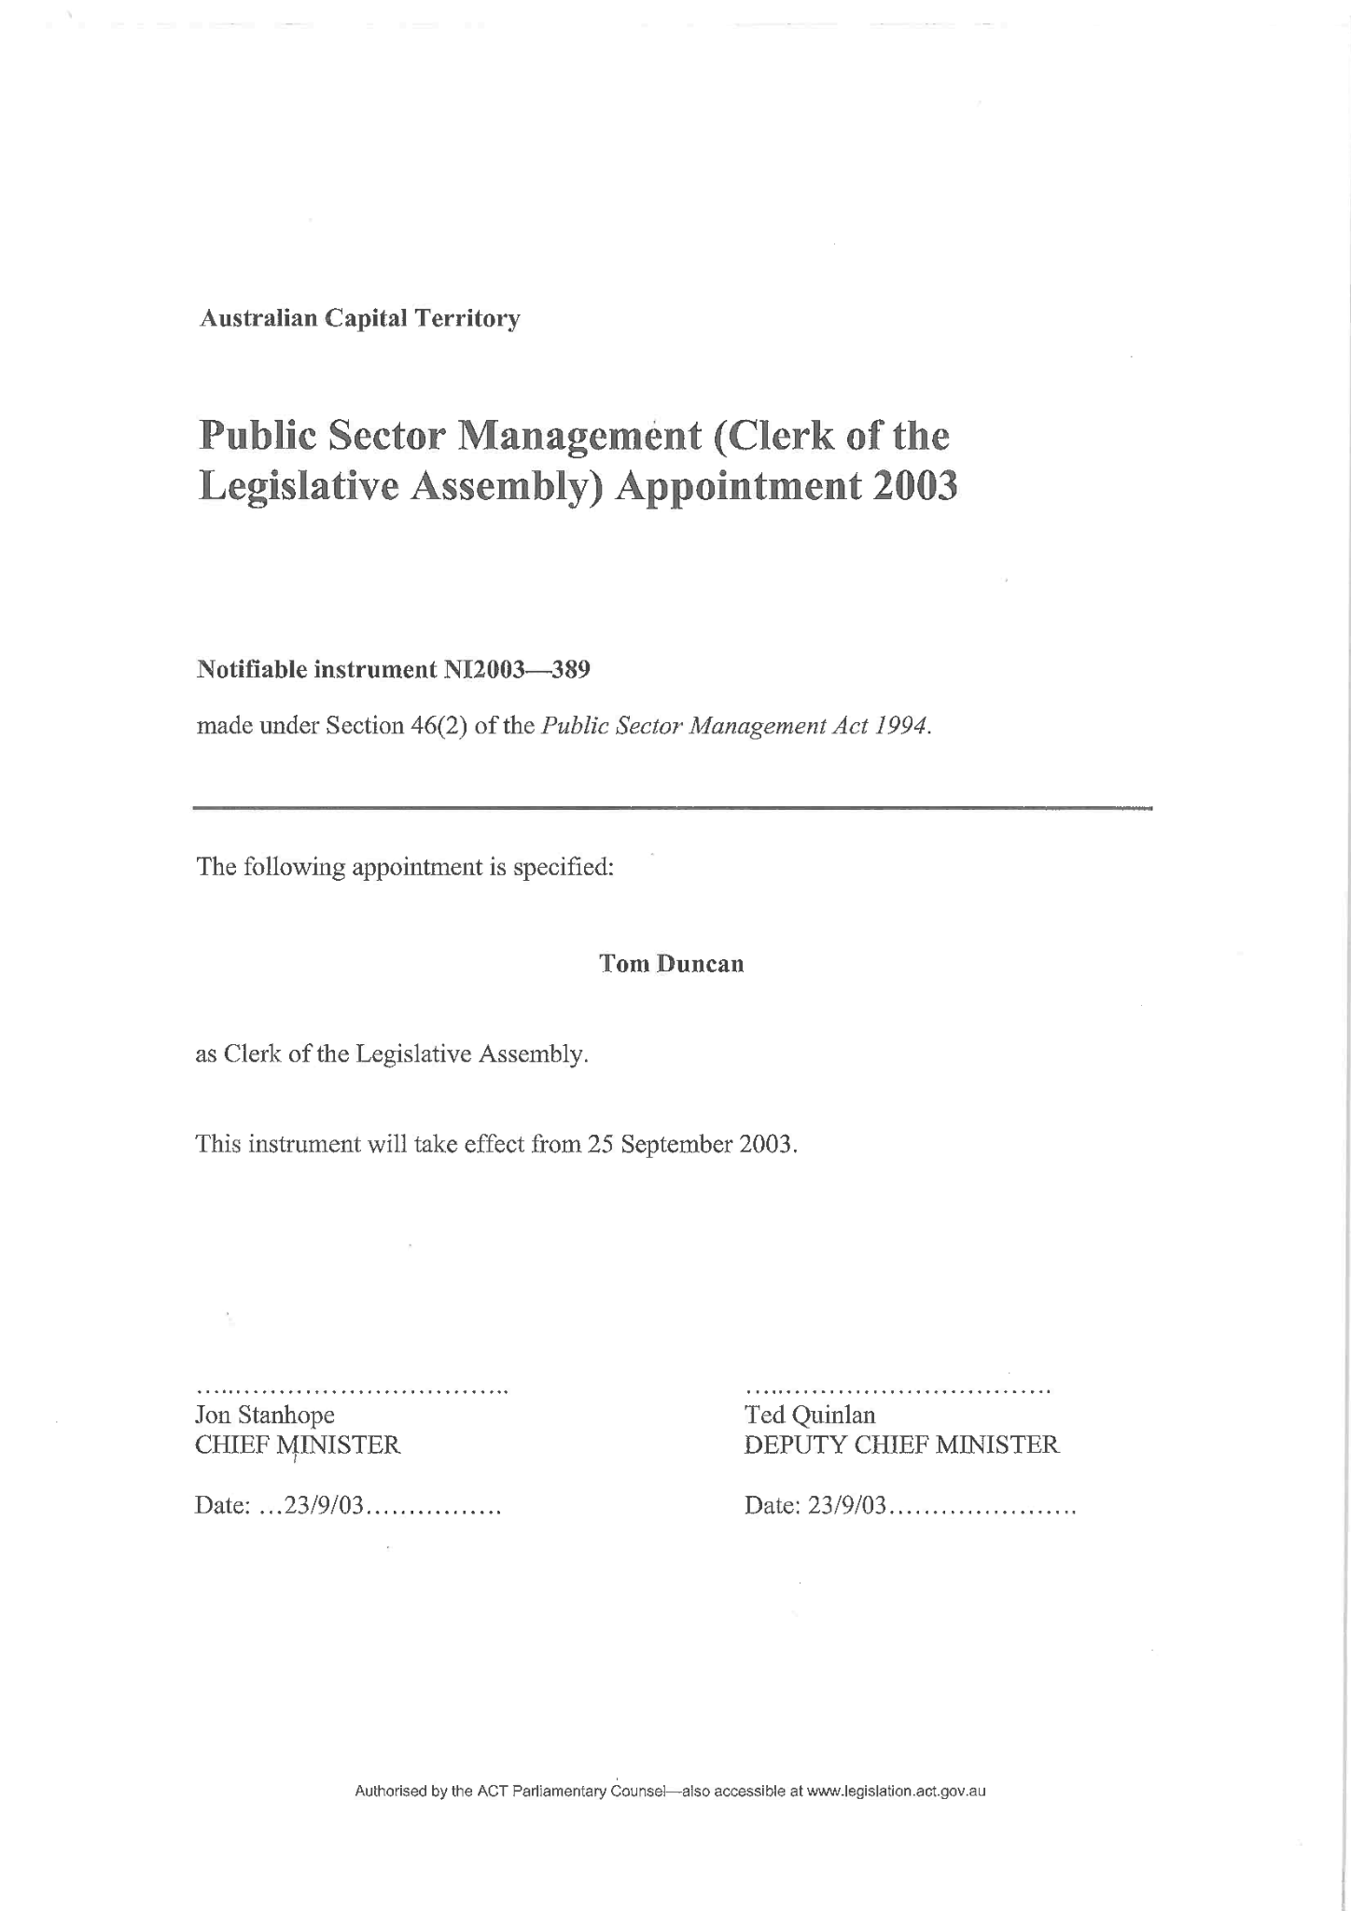
Securing independence of the parliamentary administration

Slide 11
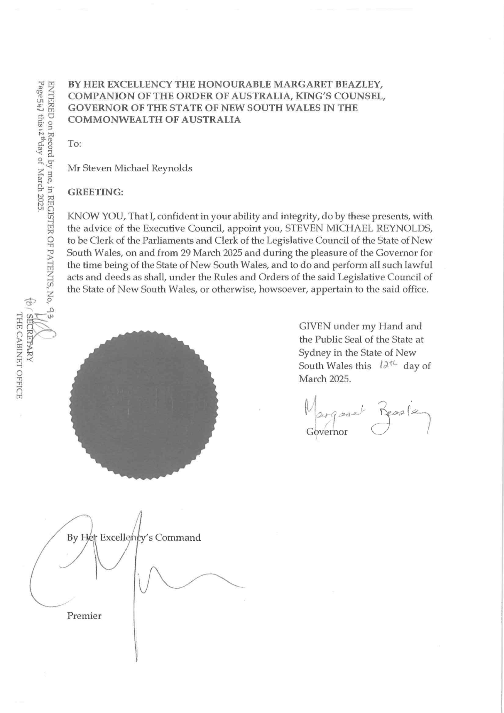
Securing independence of the parliamentary administration

Slide 12
Good governance of the parliamentary administration
entary
ration
Parliam
Administ

Slide 13
Securing financial independence
Parliament
$$
Executive
$$

Slide 14
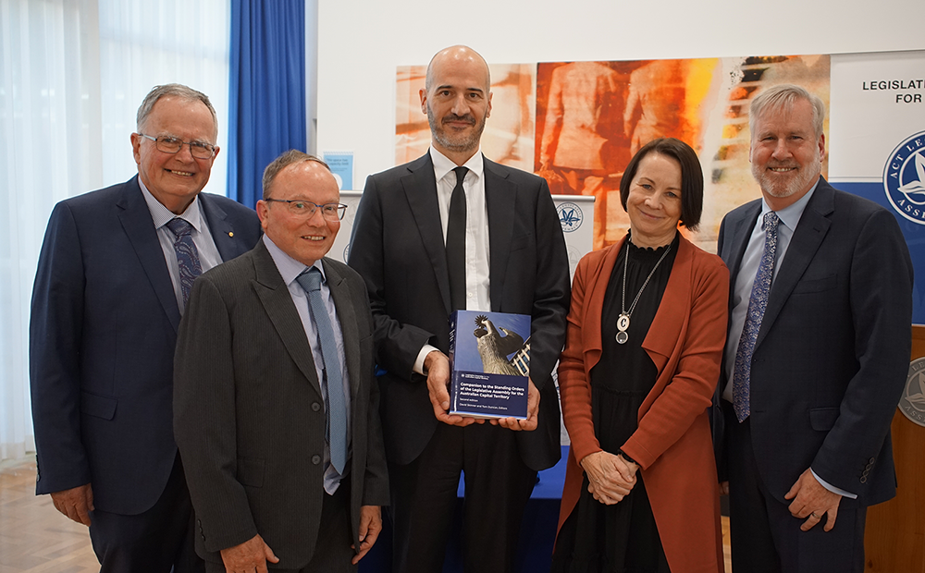
Compiling accessible and authoritative procedural information

Slide 15

Being an educator and developer of staff

Slide 16

Being an advocate for adopting best practice and innovation

Slide 17
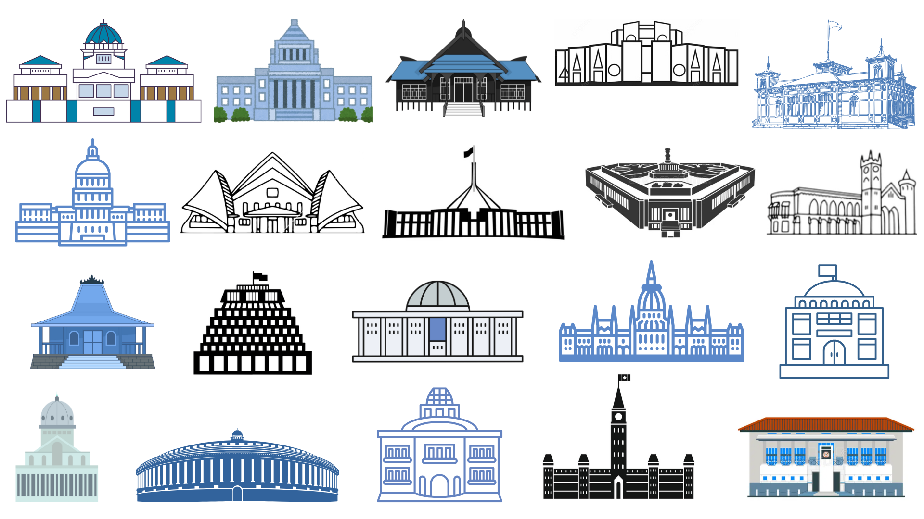
Keeping aware of other parliaments’ innovations and reforms

Slide 18

Bottom drawer of a filing cabinet in the Clerk’s Office

Slide 19
… Ensure that the holders of executive power are accountable, that is, that they are required to explain to the
legislature and the public what they are doing with the power entrusted to them.
Harry Evans

Slide 20
The Silent Reformers:
The role of Clerks in strengthening and transforming parliament
Presentation to the
Society of Clerks-at-the-Table in Commonwealth Parliaments
2025 Annual Meeting, Barbados
Tom Duncan,
Clerk of the Legislative Assembly for the
Australian Capital Territory

